Slide 1

How do we know what works?
Designing impact evaluation of policies and programmes
PANAP Annual Meeting
15th of September 2022

Slide 2
Impact evaluation
Impact (ex-post) evaluation deals with the following big question:
Does a policy/programme cause a change in the outcomes of interest?
Does participation in a farmer field school cause an increase maize yields?
As well as more practical design questions
What is the ideal size of a group participating in a farmer field school?
How can we encourage female farmers to participate?

Slide 3
Impact evaluation
Objectives include
Accountability
Assess the value of the policy/programme to justify its costs
Results-based management
Adjustments, redesign, scaling up, or cancellation of the policy/programme
General lessons

Slide 4
Challenges of impact evaluation
To answer that question, we need to know what the outcomes would have been WITHOUT the policy/programme (counterfactual)
Impact of a policy/programme = Actual outcomes – Counterfactual outcomes
Unfortunately, we can not (typically) observe the counterfactual in real life
If a farmer participated in a farmer field school, we can no longer see what yields would have been realized without participating

Slide 5
Challenges of impact evaluation
What we can easily observe are correlations
On average, farmers who participated in farmer field schools have higher maize yields than farmers who did not participate
There are several reasons why a correlation could exist
  Participation in farmer field schools increases maize yields
  OR ...
  Farmer field schools were established only in areas with high maize yields
  Motivated and ambitious farmers were more likely to participate in farmer field schools and their yields would have been higher anyway

Slide 6
Challenges of impact evaluation
The art of impact evaluation is to find methodologies that statistically establish the first reason for an observed correlation, true causality, while ruling out any of the other reasons
This is not just a technical/academic issue!
We need to know that a particular result (benefit) is truly the outcome of a particular policy or programme to make decisions on the funding/expansion/adjustment of the policy or programme

Slide 7
Finding a credible counterfactual
Average outcomes of non-beneficiaries usually do not provide a good counterfactual because non-beneficiaries are often different from beneficiaries in many dimensions
Need to “find” non-beneficiaries that are as similar to beneficiaries as possible
Designing an impact evaluation BEFORE the start of the policy/programme offers most opportunities to « find » a credible counterfactual and produce sound and rigorous evidence
But... Sometimes data collected for other purposes can also work
+ There are several econometric techniques we can apply to « mimic » a credible
counterfactual

Slide 8
Finding a credible counterfactual
Randomized controlled trial
Natural experiments
Differences-in-differences
Regressions (with controls) and matching

Slide 9

Randomized Controlled Trial
The 2019 Laureates have introduced a new approach to obtaining reliable answers about the best ways to fight global poverty. In brief, it involves dividing this issue into smaller, more manageable, questions – for example, the most effective interventions for improving educational outcomes or child health. They have shown that these smaller, more precise, questions are often best answered via carefully designed experiments among the people who are most affected.
The Laureates’ research findings – and those of the researchers following in their footsteps – have dramatically improved our ability to fight poverty in practice.

Slide 10
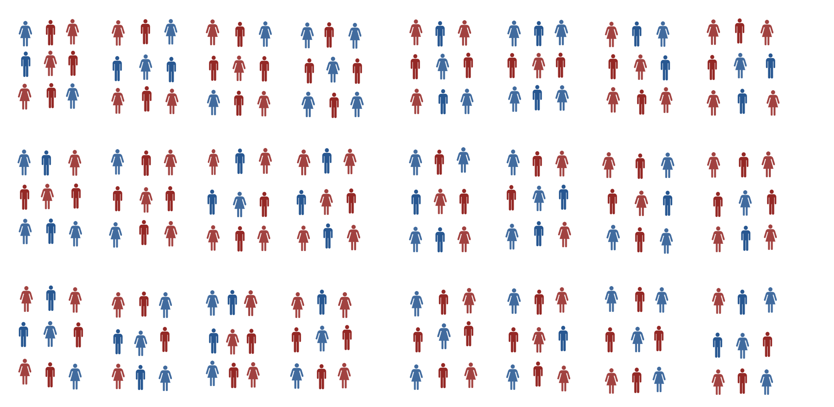
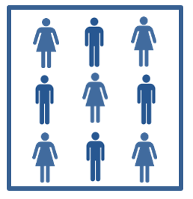
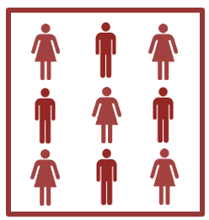
Randomized Controlled Trial
Gold Standard
Random allocation of individuals or clusters of individuals (i.e. farmer groups, villages, ...) into
  Treatment group
  Control group

Slide 11
Randomized Controlled Trial
Because the groups are created by randomization (in a sufficiently large sample), they are expected to be statistically identical
Control group = Counterfactual
Outcomes treatment group – Outcomes control group = Impact policy/programme

Slide 12
Randomized Controlled Trial: Practicalities
Randomization needs to be done (well) BEFORE the start of any policy/programme activies
Randomization requires a « list »(= sampling frame) of eligible individuals or clusters
  Certain criteria can be imposed for people/clusters to be included in the list
  Only farmers who grow maize, of a certain age, who signed up and therefore showed willingness to participate, ...
  Only cooperatives that have existed at least a certain amount of years, with a certain amount of members, ...
Randomly drawing individuals or clusters of individuals from a list (i.e. lottery draw)
  Policy/programme implementer can not exert any influence over allocation into groups

Slide 13
Randomized Controlled Trial: Practicalities
RCT’s where the treatment group takes part in a programme/can benefit from a policy and the control group is excluded are most common and offer the best opportunities to confidently measure impact
But, you can randomize different aspects
  Access
  Randomize which people or clusters will be able to participate in a programme/benefit from a policy
  Timing (of access)
  Randomize the starting time of when people or clusters will be able to participate in a programme/benefit from a policy (everyone will participate/benefit eventually)
  Encouragement
  Randomize which people or clusters will be given encouragement to participate in a programme (which is open to all eligible people/clusters)
Notes:
In many cases programs are introduced gradually
We can randomize the timing of access to the program (who is included in different phases)
Those who have not yet benefited from the program at time t serve as the control group for beneficiaries
Limits the ability to assess longer-term effects
Problem when anticipation of receiving the programme later changes behaviour

Slide 14
Randomized Controlled Trial: Practicalities
You can compare different (methods of delivering) activities and/or assess synergies between different activities by (randomly) creating multiple treatment groups
But... requires a larger sample size!
 | No farmer field school | Farmer field school
No farm visits | Control | Treatment 1
Farm visits (extension agent) | Treatment 2 | Treatment 3

Slide 15
Randomized Controlled Trial: Practicalities
Data collection (among both treatment and control group)
  BEFORE the start of the programme/policy is not strictly necessary, but considered good practice
  AFTER the policy/programme has been implemented
  (and sufficient time has passed for any effects to materialize)
  Data has to be collected in the same way for treatment and control group!
Notes:
(It is not appropriate to have program staff collect outcome data in treatment areas and professional enumerators or others collect data in the comparison areas)

Slide 16
Randomized Controlled Trial: Practicalities
Needs to be designed before the start of any programme/policy activities
Different design options will result in different required sample sizes for the groups
Treatment/control status has to be enforced (i.e. those in the control group have to be excluded from activities) and compliance has to be monitored
Usually neither increases nor decreases the number of beneficiaries, but can change the geographic spread
Notes:
In general, having program staff collect data is a
bad idea, because staff may want to see a particular outcome or the
participants may hesitate to tell the truth to the people who implemented
the program.

Slide 17
Natural experiments
Sometimes it is possible to find “natural” experiments that mimic an RCT
Factors (outside the researcher’s control) create groups (almost) randomly
  Lottery
  Random environmental shocks
  Sudden policy changes
  Random administrative errors
Difficulties
  Ascertaining that allocation was truly random
  Finding data that covers outcomes for both groups
Notes:
a natural experiment where bulk text messages (including text messages with daily price information) were banned unexpectedly across India for 12 days in 2010

Slide 18
RCTs are not always feasible (or desirable)
...and natural experiments are relatively rare
In this case, we have to rely on « observational data » and econometrics tools to find a credible counterfactual and measure impact

Slide 19
Differences-in-differences
Many of the challenges of impact evaluation derive from the problem that we are comparing groups that are different in many ways
To see if a policy/programme had an impact, we can also compare beneficiaries’ outcomes (i.e. the same group) before and after it was implemented
BUT... Other things that may have affected the outcomes could have changed over this period of time as well
Participation in farmer field school coincides with a period of extreme drought which will cause yields to be lower.
But maybe yields would have been EVEN lower without the farmer field school...

Slide 20
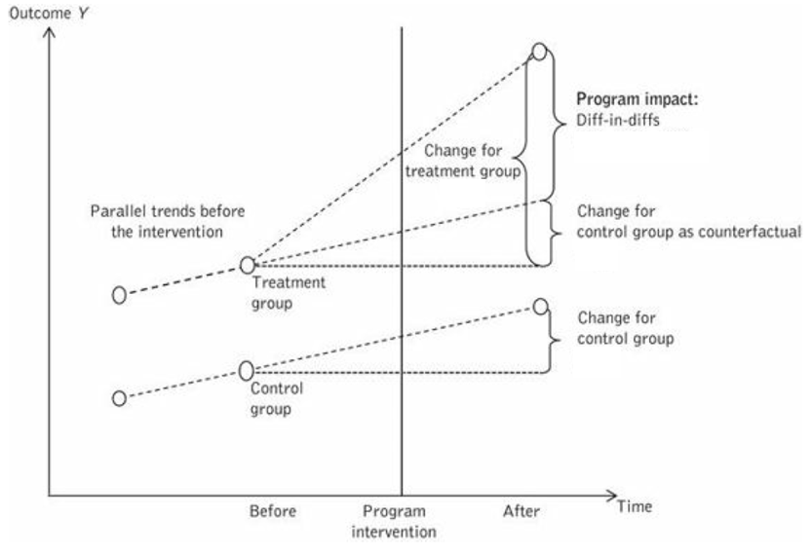
Differences-in-differences
Compare the change (before and after) in the outcomes for beneficiaries by the policy/programme to the change in outcomes for non-beneficiaries over the same period
Beneficiaries and nonbeneficiaries don’t have to be identical BUT dynamics have to be the same
  If all farmers are affected by the drought in
  the same way, the difference between the
  change in yields for farmers who participated
  in the farmer field school and those who did
  not will reflect the impact of the FFS.

Slide 21
Differences-in-differences: Practicalities
Requires panel data (i.e. collecting data on the same individuals/households/... at multiple points in time)
  Re-interviewing people can be challenging
  Problem when dropping out of the study is more/less likely for beneficiaries
Data needs to be collected before the start of any programme/policy activities
Sometimes we can apply this technique to data from general household surveys (e.g. LSMS, EHCVM) that were not collected specifically to evaluate impact of a policy/programme but do give us before- and after data for beneficiaries and non-beneficiaries

Slide 22
Regressions and matching
These 2 techniques essentially try to « make everything equal » after the fact
We can control for observed differences (e.g. age, education, household size, ...) between beneficiaries and non-beneficiaries in regressions
We can compare beneficiaries only to non-beneficiaries with similar observable characteristics (= matching)
We can only «control for» or « match on »what we observe in the data
  It is difficult to design a survey so that it captures all possibly relevant information
  Certain characteristics (e.g. motivations, aspirations, social connections) are very difficult to measure accurately

Slide 23
Regressions and matching
Unfortunately, it is usually easy to imagine that there are other unobserved variables (for which we don’t have data) that play a role
Especially problematic when
  Personal choice determines participation
  Programmes have been purposefully placed in particular areas (e.g. based on prior performance)
These 2 approaches work best for policies/programmes where selection (who could benefit) was based on (easily measured) criteria unrelated to the outcomes of interest

Slide 24
Regression and matching: Practicalities
Data collection at 1 single point in time (AFTER the start of the policy/program) is sufficient
= major advantage
Can often be done with data collected for different purposes
Need (elaborate) data on a wide range of variables (for beneficiaries and non-beneficiaries)

Slide 25
Regressions and matching: An example
Studying the impact of agricultural input subsidies in Senegal
  Outcomes of interest input use, input purchases, yields, and revenues
  Determine how different variables (age, education, ethnicity, land and livestock ownership, and whether anyone in the household has a political role or a role in a producer organization, location, ...) affect beneficiary status
  Based on these estimations, we calculate a score for all farmers (beneficiaries and non-beneficiaries) that indicates how likely it was that they would have had access to subsidized inputs
  Next, we compare the outcomes of beneficiaries to those of non-beneficiaries with a similar score

Slide 26
Regressions and matching: An example
Studying the impact of agricultural input subsidies in Senegal
  If beneficiary status is determined ONLY by these variables, we have estimated the causal effect of the subsidt programme
  However, it is likely that there other variables (income, knowledge of the programme, social status, motivation, ...) that affect which farmers can access the subsidized inputs
  AND
  those variables may also influence our outcomes of interest
  We can reflect on whether those variables we did not observe would have a positive or negative influence on the outcomes of interest
  In this case, it seems likely that people with characteristics associated with BETTER outcomes are more likely to be beneficiaries
  → WE may OVERestimate the effect of the programme

Slide 27

Thank you
© European Union 2020
Unless otherwise noted the reuse of this presentation is authorised under the CC BY 4.0 license. For any use or reproduction of elements that are not owned by the EU, permission may need to be sought directly from the respective right holders.
Slide xx: element concerned, source: e.g. Fotolia.com; Slide xx: element concerned, source: e.g. iStock.com
Notes:
Update/add/delete parts of the copy right notice where appropriate.
More information: https://myintracomm.ec.europa.eu/corp/intellectual-property/Documents/2019_Reuse-guidelines%28CC-BY%29.pdf

